Slide 1
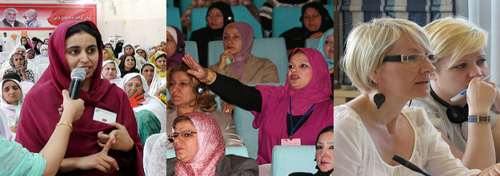
Gender Equality in European Integration Process
ECON 0462
CHP 4

Slide 2
European Political Parties and Gender Equality Women’s representation in EU

Slide 3
NO DEMOCRACY NO HUMAN RIGHTS without WOMEN´S RIGHTS

Slide 4
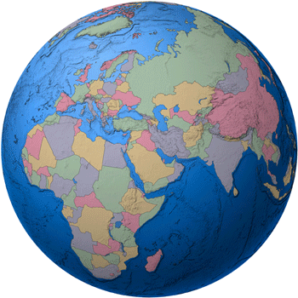
European Women’s Lobby
Established in 1990
Membership based women’s organisation from 26 countries - 23 in the EU
4000 members - largest umbrella organisations of women’s associations in the European Union (EU)

Slide 5
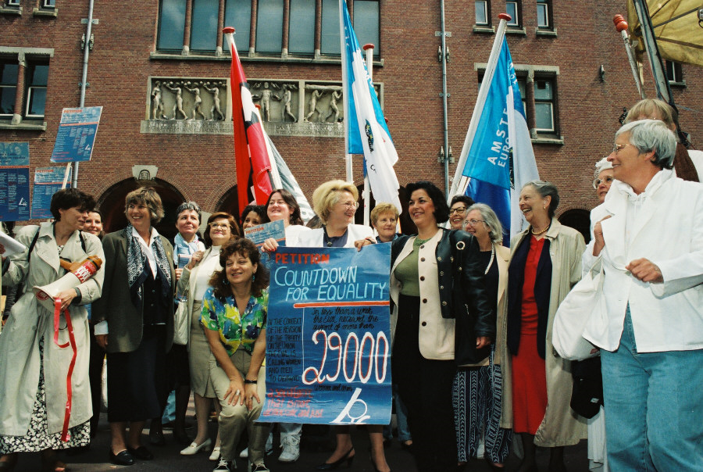
Amsterdam July 16th 1997
Source: Audiovisual Service European Union, CE | Amsterdam | P-002022/10-23

Slide 6
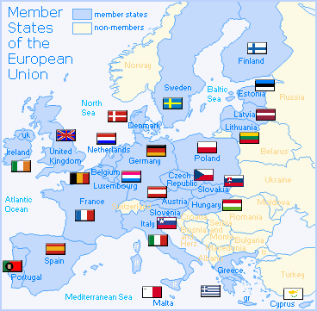
Europe
EU25 Member States: Austria Belgium Cyprus Czech Republic Denmark Estonia Finland France Germany Greece Hungary Ireland Italy Latvia Lithuania Luxembourg Malta The Netherlands Poland Portugal Slovakia Slovenia Spain Sweden United Kingdom | Candidate Countries: Bulgaria Croatia Romania Turkey Application Pending: Former Yugoslav Republic of Macedonia Population third largest population bloc in the world after China and India, with more than 450 million inhabitants. 20 official languages All member states are governed by parliamentary democracy. Seven constitutional monarchies which nevertheless rely on parliamentary government: 1957 six sign the Treaty of Rome establishing the European Economic community May 1, 2004 biggest enlargement of the EU since the dawn of European construction

Slide 7
Gender Equality
Equality between women and men is
a fundamental principle
an integral and inseparable component of human rights
Human rights of women are
inalienable, integral and indivisible part of universal human rights
Human rights of women include
their right to have control over and decide freely on matters related to their sexuality, including sexual and reproductive health

Slide 8
Parity democracy
Power sharing
Participation on an equal basis - 50/50
Compare to quotas - to achieve fair representation
Women - not ONE category
race, class, ethnicity, national origin, age, culture, disabled, migrant, Roma -
Deconstruct the white male norm
Reconstruct a multifaceted female norm

Slide 9
Election process including nominations
The current system has to be changed
with “old” boys networks and habits plus criteria linked to nationality and political parties
one proposal
Nominate for every position one woman and one man to enable equal representation or …….
and
Allow national delegations to vote only if they hav equal representation

Slide 10
Achieving economic independence of women
Pay gap
Pension gap
Time gap and care gap
Poverty and social exclusion, social protection and health care
Implementation gap - gender pact
Impact of violence against women
Minority women must be given a voice
including Romani and Sami and migrant women

Slide 11
5 areas of concern for women’s rights and economic independence
Enhancing reconciliation of work and family life
Care - care service - and who cares?
Eradicating gender-based violence and trafficking in human beings
Eliminating gender stereotypes in society
Promoting gender equality outside the EU - human rights/external policy/co-operation development

Slide 12
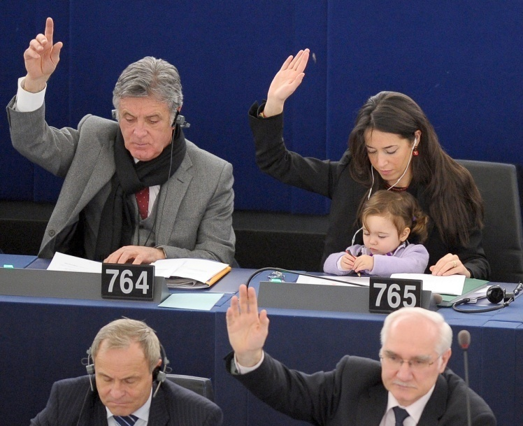
Women In PolItIcs OvervIew ObjectIves
Understand the need for women’s political participation and the related legal framework within global, regional and country-specific contexts.

Slide 13
Women In PolItIcs TopIcs
Women’s political participation: history and trends
Benefits
Obstacles
Minimum conditions
International/regional/national frameworks
Impact of women's participation
Resources

Slide 14
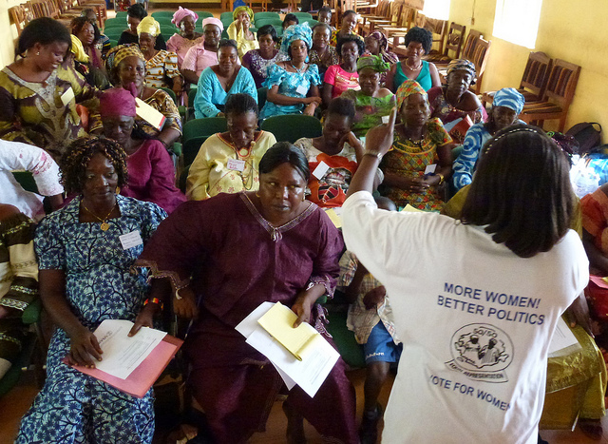
Key Terms
Empowerment
Gender equality
Critical mass
Quota
First past the post (FPTP)
Proportional representation (PR)
Transparency
Caucus

Slide 15
OVERALL GLOBAL TRENDS
Reaching parity in primary education but…
2/3 of illiterate adults are women
Women’s wages are 70-90% those of men
Women spend at least twice as much time as men on domestic work

Slide 16
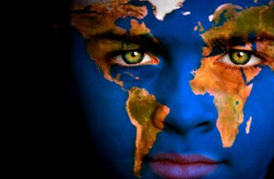
OVERALL GLOBAL TRENDS
Rates of physical violence vary from several percent to over 59%
Gender digital divide
Women more likely to live in poverty

Slide 17
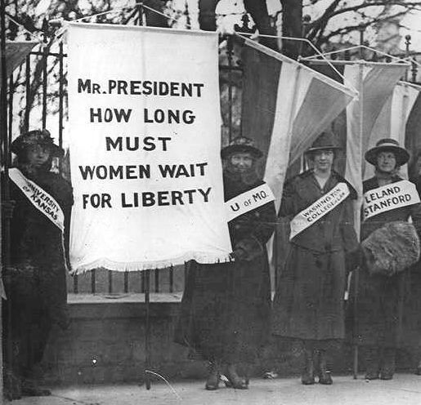
EXERCISE
Women in Politics Quiz

Slide 18
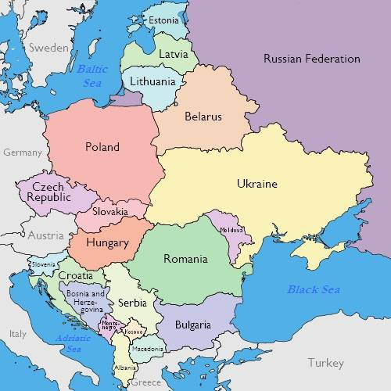
REGIONAL TRENDS
Rank Lower Upper
Kosovo 24 31.8%
Macedonia 26 30.9%
Serbia 56 22%
Bulgaria 61 20.8%
Slovakia 80 16%
Romania 103 11.2% 5.9%

Slide 19
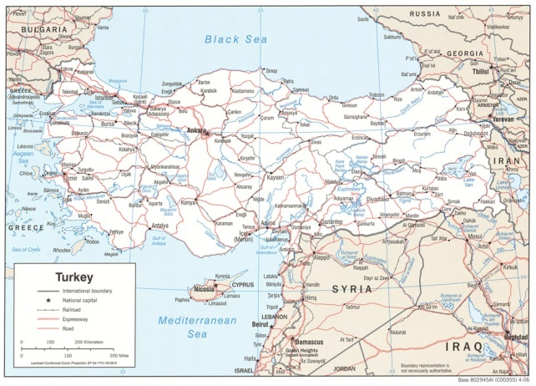
LOCAL TRENDS
1935: women’s political rights recognized
Advances in parliament: from
9% to 14%
1 parliamentary committee
chair
1 of 26 ministries headed by a woman
Men hold 82% of executive positions

Slide 20
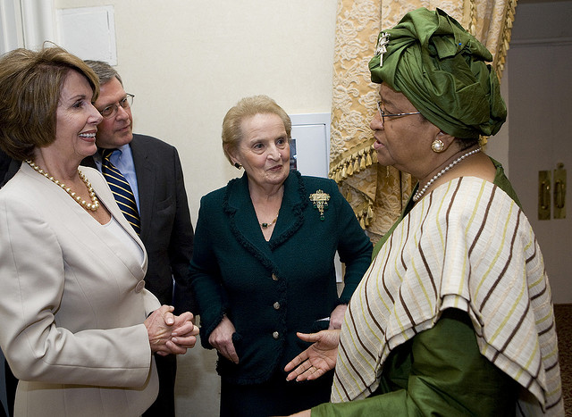
EXERCISE
Brainstorm: Why women?

Slide 21
WOMEN’S POLITICAL PARTICIPATION: BENEFITS
Higher standards of living
Concerns of marginalized voters represented
Collaborative leadership styles
Work across party lines
Peace building
Better decisions

Slide 22
BENEFITS
“Success without democracy is improbable. Democracy without women is impossible.”
“The political participation of women results in tangible gains for democracy, including greater responsiveness to citizen needs, increased cooperation across party and ethnic lines, and more sustainable peace.”
- Madeleine K. Albright

Slide 23
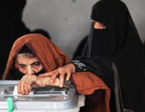
WOMEN IN POLITICS: VOTERS
Fundamental right
Barriers
Voter and civic education
When women vote, women win

Slide 24
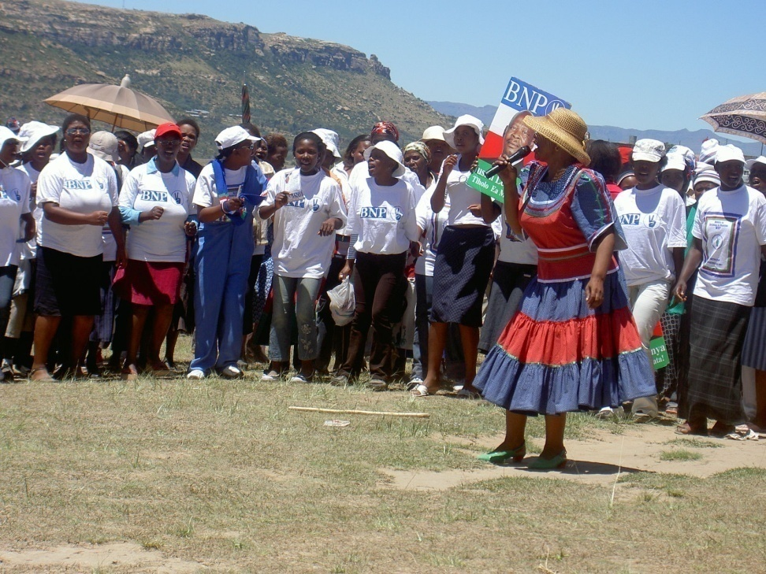
WOMEN IN POLITICAL PARTIES
Importance of women as party members and leaders
Benefits to the party
Women’s wings

Slide 25
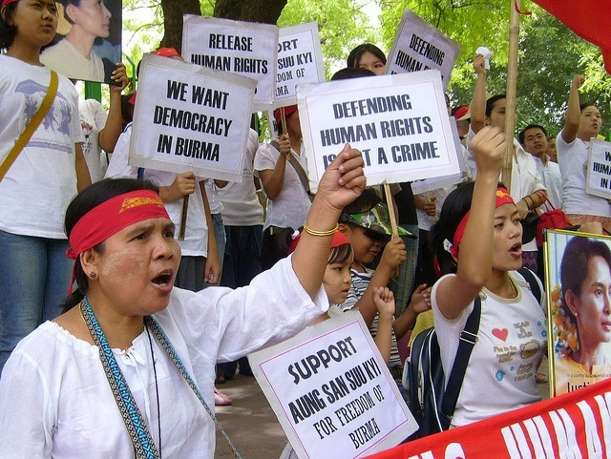
WOMEN IN CIVIL SOCIETY
Women as agents of change

Slide 26
OBSTACLES TO WOMEN’S POLITICAL PARTICIPATION
Structural
Legal
Economic
Educational
Social/cultural/religious
Time and space
Physical security
Lack of confidence

Slide 27
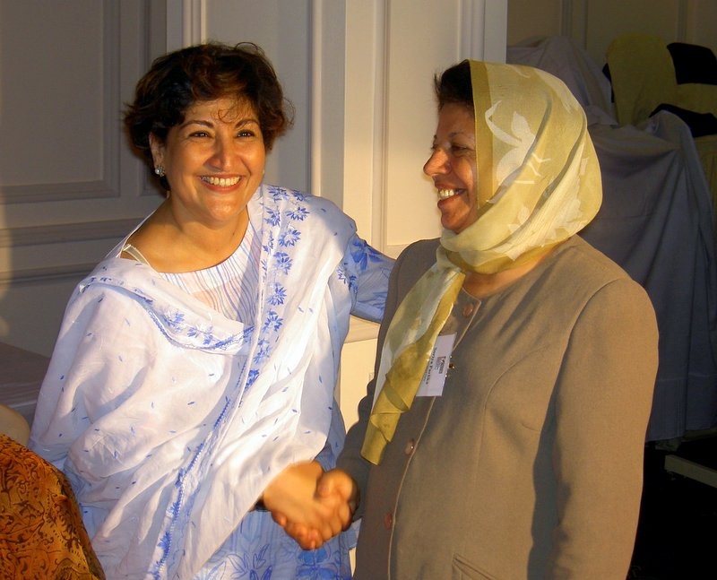
MINIMUM CONDITIONS FOR POLITICAL PARTICIPATION
Access to positions of power
Transparency
Changing cultural norms
Women’s economic empowerment
Political will

Slide 28
MINIMUM CONDITIONS
Voice
Empowerment
Critical mass
Access
Representative resources
Material and economic resources
Democratic/cultural space
Information – gender-disaggregated
Capacity

Slide 29
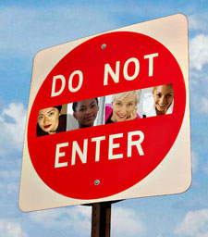
Known Barriers
The 5 C’s
CANDIDATE SELECTION
CULTURE
CASH
CHILDCARE
CONFIDENCE

Slide 30
Why it matters
The 4 Ps:
Process
Priorities
Policy
Power

Slide 31
SOLUTIONS
Gender Quota’s
Electoral (Amendment) (Political Funding) Act 2012
30% quota for political party candidates at general election levels
Rises to 40% from 2019
Failure to comply – 50% cut to annual state funding
Interacts with political parties
Women for Election
Training, Mentoring and Support for women
National advocacy campaign
Cross party network of women interested in politics
Introductions between talented women and political parties
Interacts with women (women at school, university, community, business levels and political parties)

Slide 32
SOLUTIONS
Women for Election
Softer measure – women focused
Tackles challenges that women themselves face
Demystifies politics and promotes political engagement
Acts as an advocate for societal and cultural change
Gender Quota’s
Hard measure – Legislative solution
Tackles challenges around candidate selection
Attempts to interact with systemic issues
Acts as a mechanism for change behaviour of political parties

Slide 33
Women for Election
Top line strategic overview
The top line issues at stake:
More robust political and policy decision making
Greater social cohesion
A more representative democratic system
Broader talent pool to innovate and face challenges
A more balanced participation of men and women in political life
Women for Election’s solution:
Lack of a roadmap to initiate political engagement
Lack of supportive environment to articulate a political ambition
The barriers:
Lack of awareness of the necessary skill-sets
Culture that perpetuates male dominated politics
To inspire and equip women to succeed in politics
Women for Election’s strategy:
Tiered training programme
Direct support
Networking and connecting
Communications and advocacy
Outcomes for women in politics:
More women aspire to a political life
Increased numbers of capable women candidates
Increased numbers of elected women
Increased political participation by women
Notes:
33
33

Slide 34
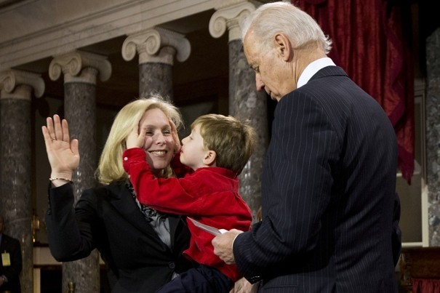
GOALS
We want MORE:
(informed) women voters
women party leaders
elected women at all levels
effective women leaders
inclusive party platforms
inclusive public policy

Slide 35
GLOBAL FRAMEWORKS
CEDAW (1979)
International bill of rights for women
Defines discrimination
States commit to end discrimination
Beijing Platform for Action (1995)
Agenda for women's empowerment
Aims to remove obstacles to women's active participation

Slide 36
GLOBAL FRAMEWORKS
Millennium Development Goals (2001)
promote gender equality and empower women
UN Security Council Resolutions
1325: Women’s participation in peace negotiations and reconstruction
Subsequent Resolutions: 1820,1888, 1889 and 1960

Slide 37
What has changed…
Political Parties actions
Forced to select women and they do
Discourse
Constituents actively recognising value of women in politics
Women’s engagement
Seeing opportunities
Media Coverage
Interesting stories
More female voices on air
Women for Election
Identified training needs specific to national elections
Engaged at some level with all female candidates
Training and networking
Advocate on behalf of female candidates – in particular around controversial selections
We have become to “go-to” organisation for media on this topic

Slide 38
DONOR POLICIES
US Agency for International Development (USAID)
SIDA, CIDA, DIFD
European Union
World Bank

Slide 39
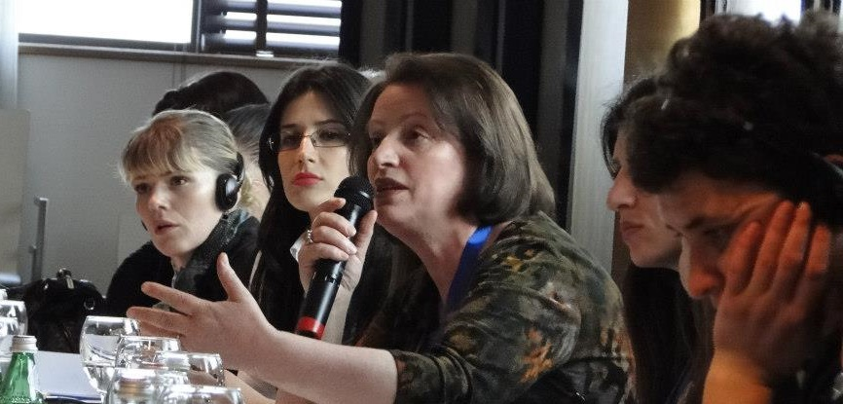
MOBILIZING WOMEN FOR CHANGE: MECHANISMS
Women’s parliamentary caucuses
Women’s wings within political parties
Civil society organizations
Cross-sector groups

Slide 41
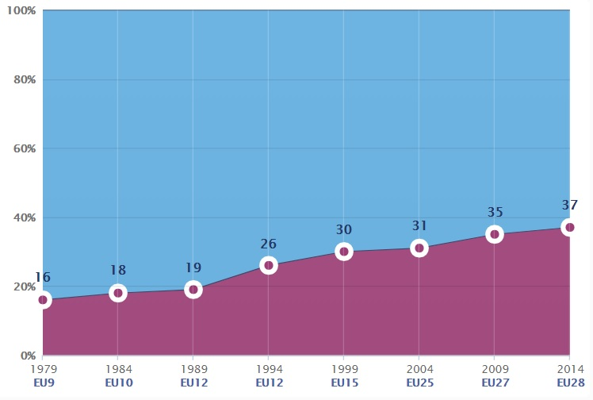
European Parliament Elections Men and Women Distribution

Slide 45
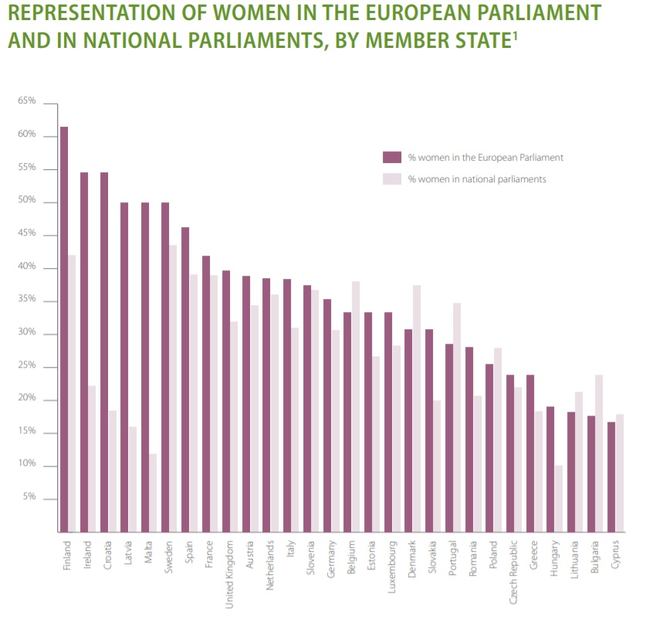

Slide 46
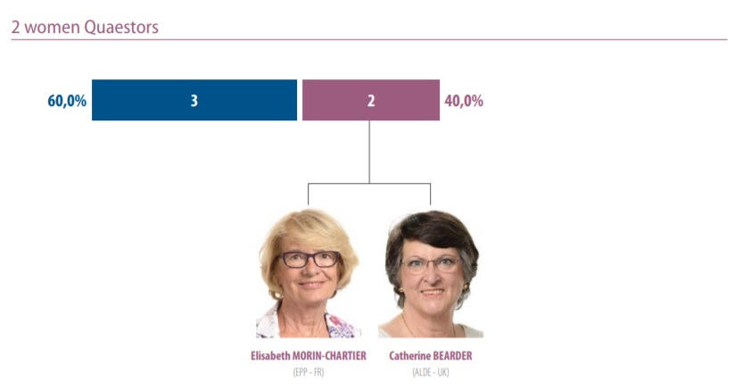

Slide 47
Steps towards Gender Equality in Politics Suggestions
Coordinated efforts to increase the number of women in politics
Actual support of women who want to be actively involved in politics (services to help them balance family, politics and professional life)
Actual support from political parties
Solidarity among women
Gender stereotypes

Slide 48
Thank you for your attention!

